Slide 1
T-Folio Training
Center for Change in Transition Services (CCTS) | www.seattleu.edu/ccts
Notes:
Welcome to the T-Folio, a transition portfolio tool for high school aged youth in Washington state, created by the Center for Change in Transition Services with funding from the Division of Vocational Rehabilitation.

Slide 2
Training Objectives, Part 1
Part 1: The Basics
What is T-Folio?
Who should use T-Folio?
How to implement the curriculum
What is included
How to navigate the lessons and activities
Notes:
This training is split into two parts. Part 1 covers the basic information needed to use the T-Folio, including what it is, who it is for, how to implement it, what is included, and how to navigate the lessons and activities. Part 2 offers tips on facilitation and collaboration between educators and agency personnel.

Slide 3
Training Objectives, Part 2
Part 2: Collaboration and Facilitation
How to collaborate effectively between educators and agency personnel
Tips from the field on collaboration
Suggestions on how to facilitate a lesson with youth
Notes:
Part 2 of this training will address effective collaboration between educators and agency personnel and will give suggestions on how to facilitate a lesson with youth.

Slide 4
Part 1: The Basics
Notes:
Part 1: The Basics

Slide 5
What is the T-Folio?
A free digital platform that helps youth in Washington state complete the items needed for their transition portfolios through a series of interactive exercises and the support of a facilitator.
Aligns with both Individualized Education Program (IEP) transition planning and the Division of Vocational Rehabilitation’s Pre-Employment Transition Services.
Schools and counselors are already required to provide transition services. The T-Folio is a supplemental tool that makes it easier!
Notes:
T-Folio is a free digital platform that helps youth, with the assistance of a facilitator, to complete the items needed for their transition portfolios through a series of interactive exercises. T-Folio aligns with both Individualized Education Program (or IEP) transition planning and the Division of Vocational Rehabilitation’s Pre-Employment Transition Service categories so both educators and agency personnel will find it useful.
Schools and counselors are already required to provide transition services. The T-Folio is a supplemental tool that makes it easier for anyone working with youth on their transition goals.

Slide 6
Transition Services
The T-Folio curriculum is aligned with the Transition Services Flowchart (Johnson, 2012) and is designed to guide youth through the process of planning for their future and setting goals for:
the IEP (Individualized Education Program)
the IPE (Individual Plan for Employment)
Notes:
The T-Folio is also aligned with the Transition Services Flowchart (by Cinda Johnson) and is designed to help guide youth through the process of planning for their future and setting goals for the IEP or the IPE (the Individual Plan for Employment).

Slide 7
Who should use the T-Folio?
T-Folio is designed for youth aged 16-25 who are in the process of transitioning from high school to post-secondary employment or higher education.
T-Folio is primarily designed for students who fall into the high incidence categories (SLD, EBD, Health Impaired, etc.)
Activities have been carefully constructed to incorporate universal design principles and can be modified to meet the needs of a wider range of student abilities.
Notes:
T-Folio is designed for youth aged 16-25 who are in the process of transitioning from high school to post-secondary employment or higher education. While the T-Folio does refer to “students” throughout the curriculum, users need not be students to use and benefit from the T-Folio.
In its current stage of development, T-Folio is designed primarily for users with learning and/or emotional behavioral disabilities. However, the activities have been carefully constructed to incorporate universal design principles and can be used by anyone making the transition to life beyond high school. It is encouraged and expected that facilitators consider the youth they are working with and accommodate or modify accordingly. Finally, lesson guides may offer suggestions for different presentation or response formats depending upon the youth’s needs.

Slide 8
How to implement the curriculum
Implement the curriculum in classes that already exist:
English Language Arts
Life Skills
Career Technical Education
Advisory
Community Experience Class
Etc.
In small groups or individually to prepare for the development of an IPE with the help of a DVR counselor.
Notes:
The T-Folio can be used in any class (such as English Language Arts, Life Skills, Career Technical Education, Advisory, Community Experience Class, etc.), or with individuals or small groups to prepare for the development of an IPE with the help of a DVR counselor.

Slide 9
Partner with others
CTE teacher
School counselor
Business partners
Guest speakers.
Use technology to invite speakers into your classroom via Zoom, Skype, etc.
Notes:
Try partnering with others in order to utilize their expertise. Teachers and DVR counselors may want to partner with a CTE teacher, the school counselor, business partners in the community, or other guest speakers. You can use technology to invite speakers virtually into the classroom via Zoom, Skype, etc.

Slide 10
Suggestions for timing when integrating T-Folio
The curriculum can be used throughout the student’s high-school career, as they will benefit from repeating or revisiting certain lessons each year.
Age appropriate assessments should be done every year.
Goals (postsecondary and annual IEP) can be written and led by the student and need to be reviewed/adjusted annually.
Preparing for employment varies as the student matures – revisiting these areas will lead to better outcomes.
Self-advocacy is an ongoing area of growth for youth as they experience and mature in their transition – revisit and practice often.
Notes:
In terms of integrating the T-Folio for use over the span of the student’s high school career, consider the following:
Age appropriate assessments should be done every year.
Goals (both postsecondary and annual IEP goals) can be written and led by the student and need to be reviewed and adjusted annually.
Preparing for employment varies as the student matures – revisiting these areas will lead to better outcomes.
Self-advocacy is an ongoing area of growth for youth as they experience and mature in their transition – revisit and practice often.

Slide 11
High School and Beyond Plan
Many T-Folio activities align with the High School and Beyond Plan (HSBP) required for all students for graduation, including:
Career Interest Inventory (see T-Folio Unit 1, Lesson 3)
Educational goals (Unit 2, Lesson 2)
Course planner (Unit 2, Lesson 5)
Personalized pathway (Unit 2, Lesson 7)
Resume/activity log (Unit 4, Lesson 2)
Notes:
T-Folio activities can be used to supplement the development of the student’s High School and Beyond Plan. Some of the High School and Beyond Plan components found in the T-Folio include:
Career Interest Inventory (T-Folio Unit 1, Lesson 3)
Educational goals (Unit 2, Lesson 2)
Course planner (Unit 2, Lesson 5)
Personalized pathway (Unit 2, Lesson 7)
Resume/activity log (Unit 4, Lesson 2)

Slide 12
T-Folio Units
Student-Centered Introduction
Unit 1: Job Exploration Groundwork
Unit 2: Postsecondary Employment and Education Options
Unit 3: Work-based Learning Experiences
Unit 4: Workplace Readiness Training
Unit 5: Self-Advocacy
Notes:
The T-Folio includes a Student-Centered Introduction and five units for a total of 36 lessons.

Slide 13
Student-Centered Introduction
A warm-up unit for both youth and facilitators.
Promotes student voice.
Emboldens the students to self-reflect and explore what is important to them and their future.
Increases understanding and ability to identify and voice future desires.
Notes:
The Student-Centered Introduction acts as a warm-up unit for both youth and facilitators. It promotes student voice and gives facilitators a baseline for each individual in terms of self-knowledge and self-determination. This focus on the student is central to the work of the T-Folio and follows from research on the importance of putting youth first in order to encourage self-determination and ensure that their needs and interests are being met.

Slide 14
Unit 1: Job Exploration Groundwork
This unit consists of 8 lessons.
A series of assessments in areas of strengths, preferences, interests, needs, self-determination, and work maturity skills.
Students will analyze results of the assessments and identify connected traits in relation to potential careers.
Notes:
Unit 1: Job Exploration Groundwork contains a series of assessments in the areas of strengths, preferences, interests, and needs, as well as self-determination and work maturity skills. Students will analyze the results of the assessments and identify connected traits in relation to potential careers.

Slide 15
Unit 2: Postsecondary Employment and Education Options
This unit consists of 7 lessons which follow the Transition Flowchart.
In this unit, participants will:
Explore and create their postsecondary education and training goals.
Chart their course of study.
Create an action plan for employment and education.
Notes:
Unit 2: Postsecondary Employment and Education Options helps students to explore their postsecondary education and training goals for their career(s) of interest. In this unit, students will create and document their goals; chart their course of study; and create an action plan for employment and education.

Slide 16
Unit 3: Work-based Learning Experiences
This unit consists of 6 lessons that assist students with cultivating experiences that will help prepare them for future careers:
Introduction to work-based learning.
Workplace skills and competencies.
Informational interviews.
Job shadowing.
Evaluations and letters of recommendation.
High School and Beyond Plan alignment.
Notes:
Unit 3: Work-based Learning Experiences consists of 6 lessons that assist students with cultivating experiences that will help prepare them for future careers. Included in this unit are: a workplace skills assessment, a lesson on informational interviewing, a job shadowing workbook, sample evaluations and letters of recommendation, and a lesson designed to align the T-Folio with the High School and Beyond Plan.

Slide 17
Unit 4: Workplace Readiness Training
This unit has 7 lessons in which students will learn about:
Work maturity skills
Writing a resume
Writing and presenting an elevator speech
Job applications
Job interview preparation
Writing a thank you note
Developing an action plan for employment
Notes:
Unit 4: Workplace Readiness Training guides students in developing skills and tools such as writing a résumé, giving an elevator speech, and applying for jobs. Students will practice filling out a job application, writing thank you letters, and answering interview questions.

Slide 18
Unit 5: Self Advocacy
This unit has 6 lessons in which students will :
Reassess their level of self-determination.
Set goals in the area of self-advocacy.
Set goals for independent living.
Learn about student-led IEPs.
Create an action plan for self-advocacy and independent living.
Review their work in the T-Folio for completion.
Notes:
The fifth and final unit, on Self-Advocacy, will reassess the youth’s level of self-determination and assist them in making goals in the areas of self-advocacy, student-led IEPs, and independent living. In the final lesson, the youth will look back on the work they’ve done in the T-Folio and make sure their portfolios are complete!

Slide 19
Getting Started
Go to www.cctstfolio.com
Chrome has the best functionality
There may be a short wait as the platform loads
Familiarize yourself with the units, lesson guides, and activities
Keep in mind as you are exploring that all Word and PowerPoint documents will download automatically, while PDFs will open in a new tab.
Notes:
There is no log-in necessary to access the T-Folio. Simply navigate to www.cctstfolio.com. Chrome has the best functionality although other browsers are compatible as well. There may be a short wait as the platform loads.
Read the information on the home page if you haven’t already.
Next, familiarize yourself with the units and lessons by navigating through the menus on each page.

Slide 20
Lesson landing page
Notes:
On the lesson landing page, you will find a summary, objectives, and links to the documents needed to complete the lesson.

Slide 21
What a typical lesson includes
Lesson guide
Activity (one or more)
PowerPoint (and PDF)
Notes:
A typical lesson includes a lesson guide, at least one activity, and a PowerPoint presentation. PDFs of the PowerPoints are provided for those who prefer a print copy or choose not to use PowerPoint. Some lessons also include samples of activities or portfolio entries so that youth can work from an example.
The lesson guides can be accessed from the lesson landing page and either followed online or printed to use in hard copy.
The activities can either be completed online and saved as a PDF or printed and filled out by hand, depending on the youth’s needs.
The lessons are intended to be used as a scaffolded set of learning activities. However, they can be used as stand-alone activities after some minor preparation with the youth.

Slide 22
Lesson Guides
Lesson guides are available on each lesson landing page and include the following:
Lesson summary and objectives
Facilitator notes
Introduction to the lesson with script suggestions
Activities
Debrief and guiding questions
Additional resources
Considerations for accommodation
Notes:
Lesson guides are available on each lesson landing page and include:
A lesson summary and objectives
Facilitator Notes with helpful information for the facilitator.
An Introduction to the lesson with script suggestions
One or more activities to facilitate with the youth, usually leading to an item for their transition portfolio
Debrief and Guiding Questions which helps youth to assimilate what they have learned
And finally, Additional Resources and Considerations for Accommodation

Slide 23
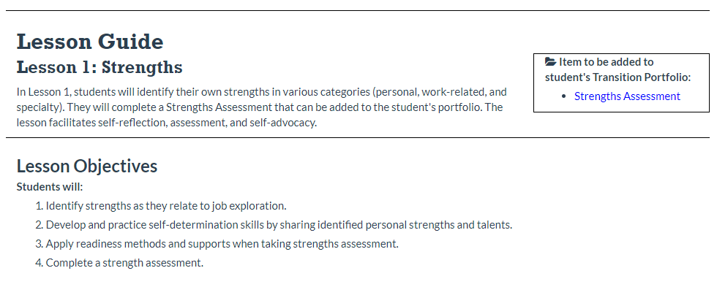
Lesson Guide: Example
Notes:
This is an example of a lesson guide from Unit 1, Lesson 1. Any items to be added to the student’s transition portfolio are noted in the box at the top right corner.

Slide 24
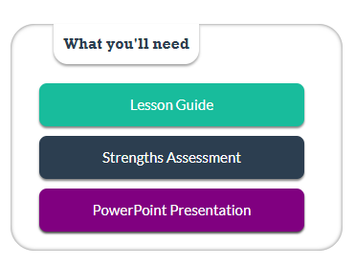
Accessing the PowerPoint
Notes:
The PowerPoint presentation can be downloaded from the lesson landing page, as shown in the image, or from the lesson guide.

Slide 25
PowerPoints
Most lessons have an accompanying PowerPoint to use as presentation or guide.
Guides the facilitator and youth through the lesson.
Many slides have notes that support the information on the slide.
Includes links to the activities to be used in the lesson.
The PowerPoints are left purposefully sparse to meet maximum accessibility requirements. However, facilitators can feel free to add images or transitions according to preference.
Notes:
Like the lesson guide, the PowerPoint presentation guides the facilitator and youth through the lesson. The PowerPoint can be used as a presentation in the classroom, or it can be used for your information as you prepare the lesson. Many slides have notes that support the information on the slide, so be sure to read the PowerPoint (or the PDF version if you prefer), including the Notes section, before conducting the lesson.
If you use the PowerPoint in the classroom, be sure to note where there are links to external websites that will be part of the activity. You may want to pull these up ahead of time or be ready to instruct the youth on how to find them.
The PowerPoint can be modified or adapted as needed.

Slide 26
Accessing the activities
Notes:
The activities can be accessed from the lesson landing page, as shown in the image, or from the lesson guide.

Slide 27
Activities
Each lesson has at least one activity for the youth to complete.
The lesson guide provides the facilitator with directions and locations of the activity(s).
There is a “product” at the end of each activity that will need to be saved in some location as a PDF:
Cloud-based
Thumb drive
Printed portfolio
Notes:
Each lesson has at least one activity for the youth to complete. The lesson guide provides the facilitator with directions and links to the activity(s).
There is a “product” at the end of each activity that will need to be saved in some location as a PDF. We recommend that students have a designated location for their transition portfolio files so that they can be easily organized, whether cloud-based, a thumb drive, or a physical folder.

Slide 28
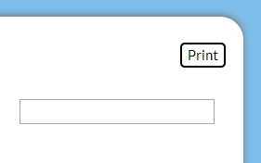
Save your work
Important! The T-Folio will not store any of the user’s work or information. It is therefore recommended that youth save their work once it is completed by creating a PDF of the activity.
First, after the activity has been completed, click on the “Print” button.
Notes:
It is important to remember that the T-Folio will not store any of the user’s work or information. It is therefore recommended that youth save their work once it is completed by creating a PDF of the activity.
First, after the activity has been completed, click on the “Print” button.

Slide 29
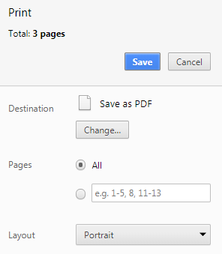
How to “Save as PDF”
Then, from the print screen, choose "Save as PDF” by changing the printer destination.
Notes:
Then from the Print screen, choose “Save as PDF” by changing the printer destination. This may look different depending on your operating system.

Slide 30
Where to save work
Choose a descriptive file name and save to a place where the student will be able to access it (local computer, thumb drive, school district server).
Once the form is saved, it can also be printed and added to the student’s file.
Plan activities to be completed in one sitting to avoid lost work.
Notes:
Next, choose a descriptive file name and save to a place where the student will be able to access it (local computer, thumb drive, school district server).
Once the form is saved, it can also be printed and added to the student’s file.
Since the T-Folio does not store the user’s work, be sure to plan activities so that they can be completed in a single sitting. Allow youth ample time to complete full activities before they are saved as a PDF.

Slide 31
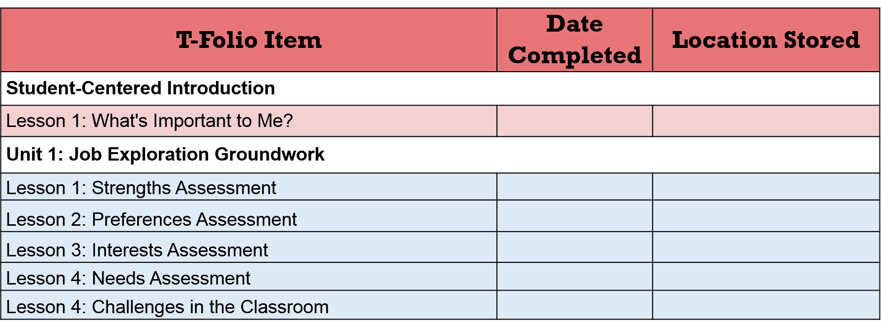
T-Folio Tracker
The T-Folio Tracker is how youth will track their work.
Notes:
After an item has been saved and added to the student’s transition portfolio, students can mark it as completed on the T-Folio Tracker.
This is how youth will track their work and remember where they have stored their documents. The T-Folio Tracker is a Word document that can be accessed from the T-Folio home page, or from the Introduction, Lesson 1, and then stored along with the student’s other transition portfolio documents.

Slide 32
The “White List”
Some schools and organizations have firewalls or other protections in place that block access to T-Folio content.
A "white list" is available for download for your IT department to add to the list of URLs recognized as safe.
The T-Folio White List can be accessed from the CCTS website.
Notes:
Some schools and organizations have firewalls or other protections in place that block access to some T-Folio content. A "white list" is available for download that can be given to your IT department to add to the list of URLs recognized as safe. The white list can be accessed from the Help page or by clicking the link in this slide. The link will direct you to a Google spreadsheet which you can share or download as an Excel file.

Slide 33
Part 2: Collaboration & Facilitation
Notes:
Part 2: Collaboration and Facilitation

Slide 34
Collaboration
The T-Folio curriculum can be co-facilitated by school personnel and DVR.
The curriculum is designed to be flexible in its delivery where all or some lessons can be co-facilitated.
The ideal implementation would allow for planning time where both facilitators identify their areas of focus and expertise as they prepare for working with youth.
Notes:
One option we encourage is for the T-Folio curriculum to be co-facilitated by school personnel and DVR. The curriculum is designed to be flexible in its delivery where all or some of the lessons can be co-facilitated. The ideal implementation would allow for planning time where both facilitators identify their areas of focus and expertise as they prepare for working with youth.
The power of collaboration is multifaceted, where each facilitator brings knowledge and skills to the experience that the other may not have.

Slide 35
Tips for successful collaboration
Establish rapport.
Identify your styles and use them to create a cohesive instructional setting.
Discuss strengths and weaknesses.
Discuss individualized needs and overall goals.
Formulate a plan of action and act as a unified team.
Take risks and grow.
Notes:
Establish rapport. Establish a relationship. Learn each other’s professional language as well as getting to know each other on a personal level. A positive relationship will help minimize misunderstandings, motivate you, and model collaboration and teamwork that is essential in the workplace.
Identify your styles and use them to create a cohesive instructional setting. Find a balance that makes everyone comfortable. Plan lessons together and use your styles to complement and enhance the lessons and the delivery of instruction. Create a cohesive instructional setting with consistent expectations about instruction and discipline styles.
Discuss strengths and weaknesses. Identify your strengths and allow the other person to be the lead in those areas in which they are strongest. By using these strengths, instruction can be differentiated to meet the needs of a larger group more frequently, as well as allowing for individualized instruction.
Discuss individualized needs and overall goals. It is important to discuss modifications and accommodations as well as the goals and objectives for each lesson to ensure student success in the instructional setting.
Formulate a plan of action and act as a unified team. Consider the following items in your plan of action: scheduling; expected participant behaviors; what you will tolerate as well as how you will respond to actions that are not acceptable; and how you plan to maintain consistency. Determine your roles in advance so that you do not contradict each other or foster misunderstandings.
Take risks and grow. Take risks, learn from each other, and grow as professionals. Find a rhythm that works and grow with your successes and through your mistakes. Remember you have a partner in this adventure that you can rely on to support the learning of the participants.

Slide 36
Classroom teachers
Review the curriculum together.
Ask for support.
Support your co-facilitator.
Create a calendar of instruction.
Notes:
As classroom teachers, it is important to create time to talk with DVR personnel about the importance of their expertise, which will positively influence outcomes for students with disabilities. This is an exciting opportunity to bring new knowledge and skills into your classroom with support from experts in the field of employment.
A few tips to keep in mind for effective collaboration:
Review the curriculum together and decide which areas would be most effectively provided collaboratively. This may be a few lessons, entire units, or the complete curriculum.
Don’t be afraid to ask for support in the areas where you feel your knowledge may not be strong.
Support your co-facilitator with some instructional strategies. (Remember they may not have any background in pedagogical practices).
Create a calendar of instruction to ensure availability. Strategize dates for collaboration based on the T-Folio curriculum schedule.

Slide 37
DVR personnel
Believe that all students should be held to high expectations.
Bring your best.
Expect that you will have a positive impact in every youth’s life.
Believe that all students can succeed.
Be flexible with timing.
Be prepared to change course.
Have fun!
Notes:
DVR personnel: Your expertise is important to the successful transition of students with disabilities. As you start to work with teachers in your local high schools, you will begin to realize that many of the goals are the same for you as they are for schools. The collaboration between schools and DVR will lead to smoother transitions for youth as they move from school to the community.
It may be daunting to enter a classroom in a high school. Remember you have a partner that is vested in the success of the youth in their classroom – they have your back. Some suggestions for success:
Believe that all students can learn and should be held to high expectations.
Bring your best to the instructional setting – you set the tone of the day.
Expect that you will have a positive impact in every youth’s life.
Believe that all students are expected to become responsible and productive citizens who will develop into lifelong learners.
Be flexible with timing: you never know how long a lesson will take until you have some practice, and it may change each time!
Be prepared to change course depending on the response of the youth.
Have fun!

Slide 38
Tips from the field for DVR counselors
Talk to teachers before implementing T-Folio in the classroom about what their students need.
Go through the activities and think about what students need and what isn’t being delivered in the classroom – don’t duplicate those services.
Share with teachers some of the information you’ll be covering before going into the workshop – you’ll be more effective as a team in making sure students are really grasping the concepts.
Check for comprehension, have the students share out, be conversational.
Notes:
Talk to teachers before implementing T-Folio in the classroom about what their students need.
Go through the activities and think about what students need and what isn’t being delivered in the classroom in order not to duplicate services.
Share with teachers some of the information you’ll be covering before going into the workshop.
When facilitating with students, be sure to: check for comprehension, have the students share out frequently, be conversational. The T-Folio lesson plans help to guide facilitation in an intentional manner.

Slide 39
Reminders about facilitation
DON’T:
Start out with your own knowledge.
Follow a pre-set curriculum.
Lecture from the “stage.”
Provide information in one direction.
Act as if there is a “right” answer.
Maintain a hierarchical relationship with pupils.
Answer all questions yourself.
→
→
→
→
→
→
→
DO:
Start by assessing the group.
Consider new ideas brought in by the group.
Use practical, participatory methods.
Make sure information flows in all directions and learning happens among all participants.
Encourage and value different views.
Consider participants as being equal.
Ask participants what they think and let them figure things out for themselves.
(Adapted from Geijer, 2015)
Notes:
A few reminders about facilitation
Don’t:
Start out with your own knowledge
Follow a pre-set curriculum.
Lecture from the “stage.”
Provide information in one direction.
Act as if there is a “right” answer.
Maintain a hierarchical relationship with pupils.
Answer all questions yourself.
Do:
Start by assessing the group.
Consider new ideas brought in by the group
Use practical, participatory methods.
Make sure information flows in all directions and learning happens among all participants.
Encourage and value different views.
Consider participants as being equal.
Ask participants what they think and let them figure things out for themselves.

Slide 40
References
Geijer, C. C. (2015, January 15). Teaching vs. facilitating: What is the difference? Retrieved from: https://www.linkedin.com/pulse/whats-difference-between-teacher-facilitator-christina-geijer
Johnson, C. E. (2012). Transition Services Flowchart. Center for Change in Transition Services, Seattle University. Seattle, WA.
Notes:
These references were used in the creation of this training.

Slide 41
CCTS Contact
CCTS General Information
ccts@seattleu.edu
206-296-6494
www.seattleu.edu/ccts
Notes:
And finally, if you still have questions about the T-Folio, please contact us at CCTS. You can email us at ccts@seattleu.edu, or call 206-296-6494.

Slide 42
Creative Commons License
Except where otherwise noted, content in this presentation is licensed under a Creative Commons Attribution 4.0 International license. All logos and trademarks are property of their respective owners.
You may share and adapt this material, but you must give appropriate credit, provide a link to the license, and indicate if changes were made.
Notes:
Unless otherwise noted, the material in this presentation is licensed under a Creative Commons Attribution 4.0 International license. All logos and trademarks are property of their respective owners. You may share and adapt this material, but you must give appropriate credit, provide a link to the license, and indicate if changes were made.

